Slide 1
FHIM Terminology Review: Laboratory domain
6 February 2013

Slide 2
Model Orientation
Model use: coordination of inter-agency communications
Model package structure (www.fhims.org)
Laboratory package orientation
Sources: VHIM, HL7 V2, HITSP, agency participation
Use case: current lab report requirements
Not lab automation
Additional elements if persuasive

Slide 3
Terminology Process
Review existing values from source specifications
HL7 V2, V3, HITSP specifications
Research other options
HITSP-designated terminologies (e.g., LOINC, SNOMED)
Current efforts, e.g. Lab Community of Practice
Agree jointly on best solution

Slide 4
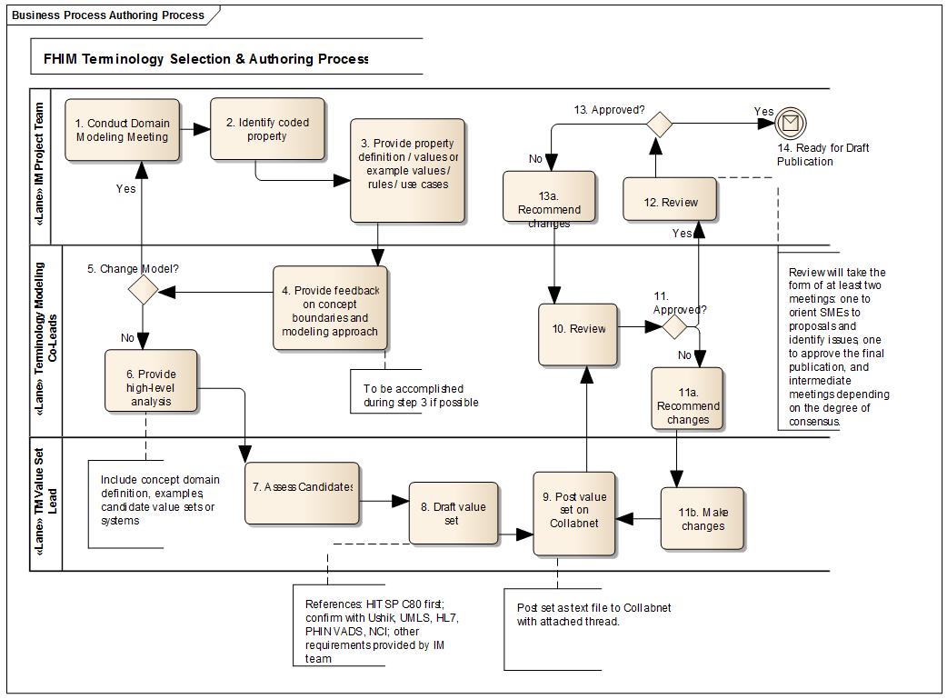
Formal Process A

Slide 5
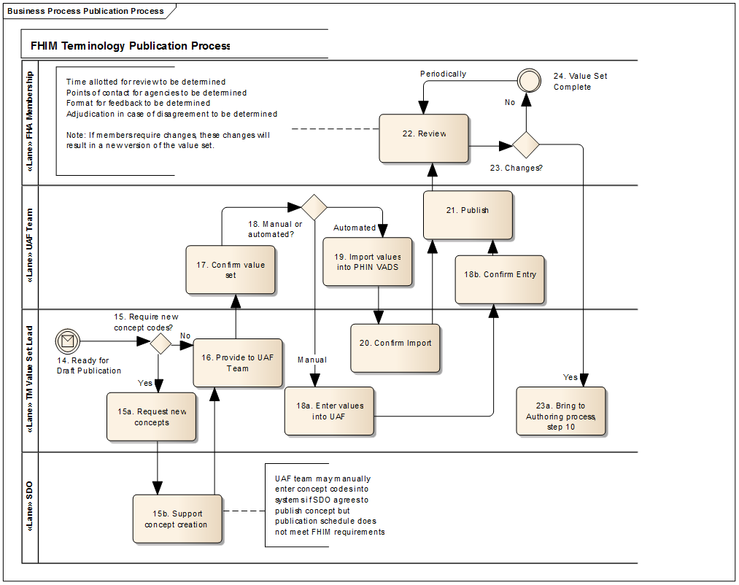
Formal Process B

Slide 6
Terminology Artifacts
FHIM information model
Requirements: List of coded elements
Working note: proposed solution
Value sets
Named in master spreadsheet
Attached in zip file
Comment form
For ease, uniformity: not required

